Slide 1
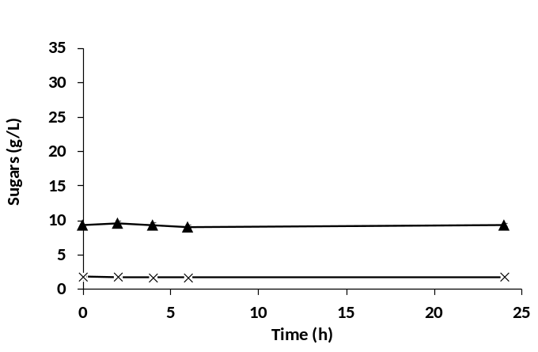
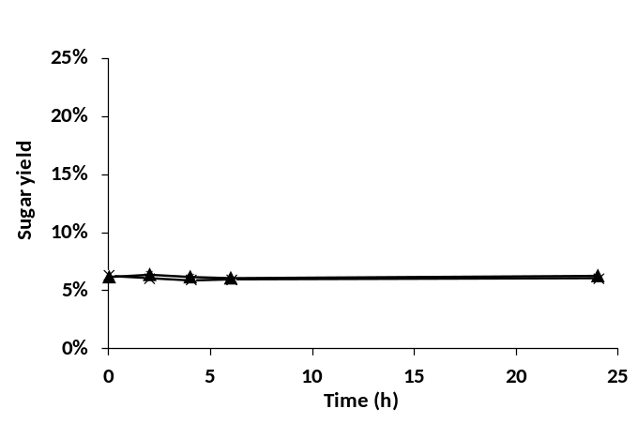
Figure S1: Effect of enzymatic hydrolysis conditions on different concentrations of Camelina meal without addition of the NS22119 cocktail (negative control). Sugar released (upper panel) and sugar yield from biomass (lower panel) over time. Values are the means of three independent experiments.

Slide 2
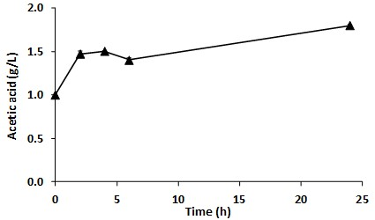
Figure S2: Acetic acid released during enzymatic hydrolysis. The concentration of acetic acid released from 15% Camelina meal by treatment with NS22119 cocktail (11.9% w/w_{Camelina meal}) was evaluated over time. Values are the means of three independent experiments.

Slide 3
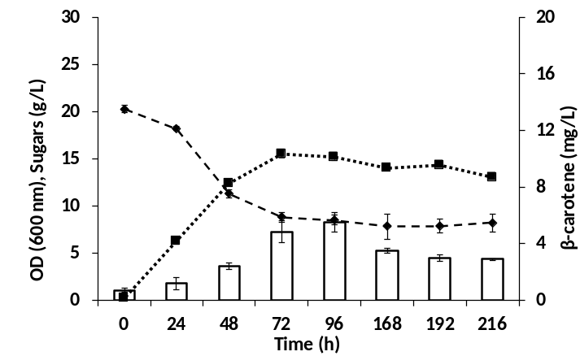
Figure S3: R. toruloides production of carotenoids from 15% Camelina meal hydrolysate. OD (dotted line), sugars consumption (dashed line), and β-carotene producion (white bars) by R. toruloides during the SHF process. Values are the means of three independent experiments

Slide 4
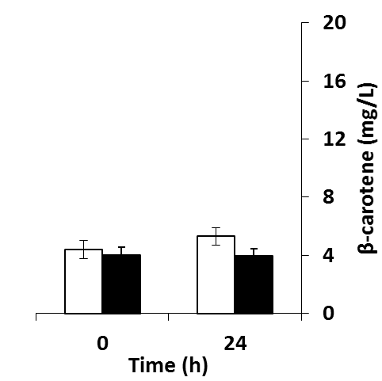
Figure S4: Carotenoids extraction from Camelina meal hydrolysate. Experimental conditions: 30°C, 160 rpm with (black bars) or without (white bars) the addition of the enzymatic cocktail. Values are the means of three independent experiments.

Slide 5
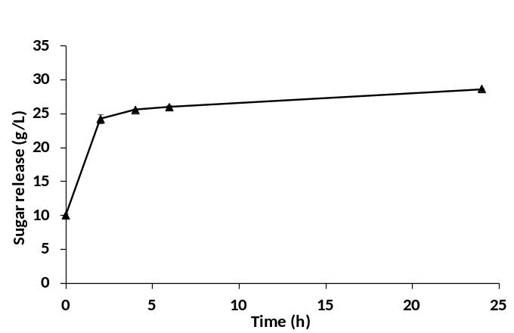
Figure S5: Effect of enzymatic hydrolysis on 15% Camelina meal by the NS22119 cocktail (11.9% w/w_{Camelina meal}) at 30°C during SSF. Values are the means of three independent experiments.

